Slide 1
Programming for problem solving
Presented by,
Devipriya M
Assistant professor
SRM IST Trichy

Slide 2
Pointers
A pointer variable is, therefore, nothing but a variable that contains an address, which is a location of another variable in memory.
During execution of the program, the system always associates the name quantity with the address 5000. (This is something similar to having a house number as well as a house name.)
We may have access to the value 179 by using either the name quantity or the address 5000.
Since memory addresses are simply numbers, they can be assigned to some variables, that can be stored in memory, like any other variable. Such variables that hold memory addresses are called pointer variables.

Slide 3
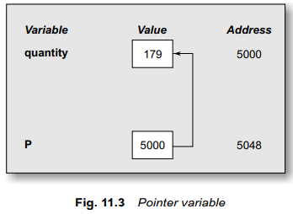
Pointers
p = &a; /* Referencing */
The operator * (star) used in front of the name of the pointer variable is known as pointer or dereferencing or indirection operator.

Slide 4


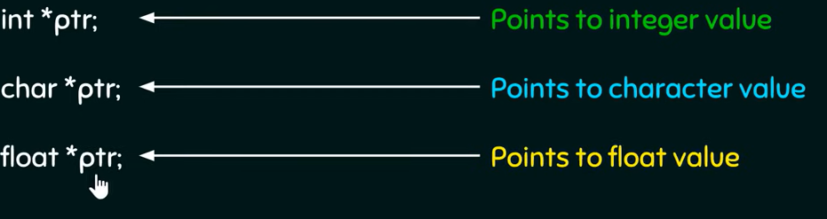
Declare a pointer variable

Slide 5
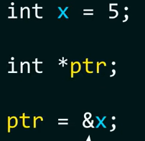
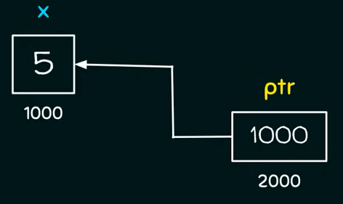

Initialize a pointer

Slide 6
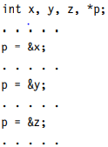
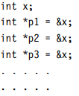
Pointers
Pointers are flexible. We can make the same pointer to point to different data variables in different statements.
We can also use different pointers to point to the same data variable.

Slide 7




Slide 8
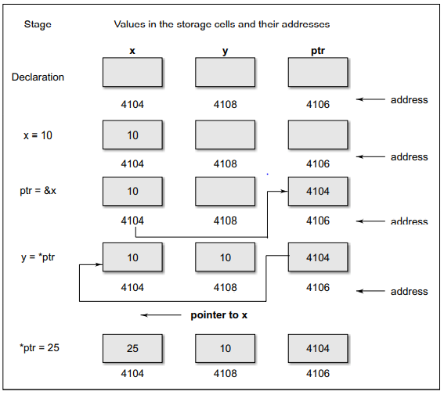

Slide 9

Like other variables, pointer variables can be used in expressions. For example, if p1 and p2 are properly declared and initialized pointers, then the following statements are valid:
C allows us to add integers to or subtract integers from pointers, as well as to subtract one pointer from another.
p1 + 4, p2–2, and p1 – p2 are all allowed. If p1 and p2 are both pointers to the same array, then p2 – p1 gives the number of elements between p1 and p2

Slide 10
The above expressions are valid.
The expressions such as p1 > p2, p1 = = p2, and p1 != p2 are allowed.
We may not use pointers in division or multiplication.
For example, expressions such as p1 / p2 or p1 * p2 or p1 / 3 are not allowed.
Similarly, two pointers cannot be added. That is, p1 + p2 is illegal.

Slide 11
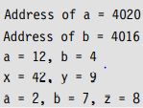
main()
{
int a, b, *p1, *p2, x, y, z;
a = 12;
b = 4;
p1 = &a;
p2 = &b;
x = *p1 * *p2 – 6;
y = 4* – *p2 / *p1 + 10;
printf(“Address of a = %u\n”, p1);
printf(“Address of b = %u\n”, p2);
printf(“\n”);
printf(“a = %d, b = %d\n”, a, b);
printf(“x = %d, y = %d\n”, x, y);
*p2 = *p2 + 3;
*p1 = *p2 – 5;
z = *p1 * *p2 – 6;
printf(“\na = %d, b = %d,”, a, b);
printf(“ z = %d\n”, z);
}

Slide 12
We have seen that the pointers can be incremented like
p1 = p2 + 2;
p1 = p1 + 1;
and so on. Remember, however, an expression like
p1++;
will cause the pointer p1 to point to the next value of its type. For example, if p1 is an integer pointer with an initial value, say 2800, then after the operation p1 = p1 + 1, the value of p1 will be 2802, and not 2801.
That is, when we increment a pointer, its value is increased by the ‘length’ of the data type that it points to. This length called the scale factor.

Slide 13
The number of bytes used to store various data types depends on the system and can be found by making use of the sizeof operator.
For example, if x is a variable, then sizeof(x) returns the number of bytes needed for the variable.

Slide 14
Pointer dereference
When the pointer is dereferenced, the indirection operator indicates that the value at that memory location stored in the pointer is to be accessed rather than the address itself.

Slide 15
Void Pointers
Pointers can also be declared as void types. void pointers cannot be dereferenced without explicit type conversion.
This is because being void the compiler cannot determine the size of the object that the pointer points to.
Though void pointer declaration is possible, void variable’s declaration is not allowed.
A pointer points to an existing entity. A void pointer can point any type of variable with proper type casting. The size of a void pointer displayed will be two.
When a pointer is declared as void two bytes are allocated to it. Later using type casting, a number of bytes can be allocated or deallocated.

Slide 16
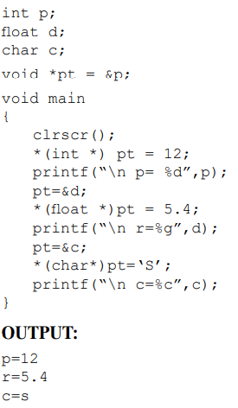
Void pointers

Slide 17
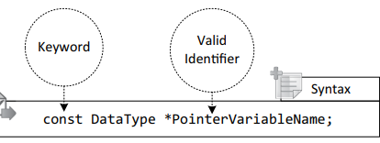
Constant pointers
When a pointer is not able to change the value of a variable to which it points, it is known as a pointer to a constant.
Suppose a pointer p points to an integer variable x, but p cannot change the value of x, then p is called a pointer to a constant.

Slide 18
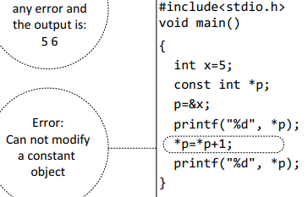
Constant pointer

Slide 19
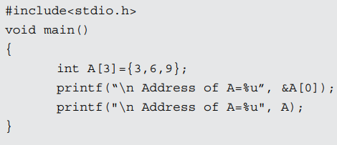

Pointers and arrays
The array name is itself a constant pointer.
That means when we print the first element’s address, or we want to print the array name, both will give same output.

Slide 20

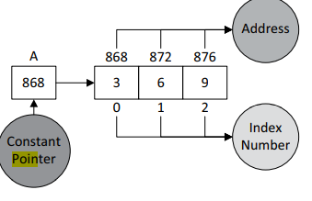
then the output will be 3, because the * operator is the value at address operator and shows the value at address A, which is 3. So, to access the other elements of the array we use A.

Slide 21
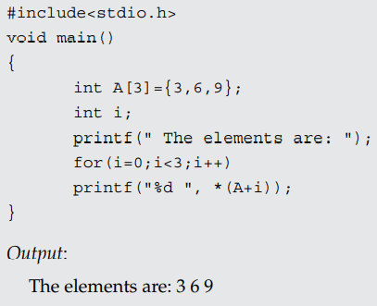
Pointers and arrays

Slide 22
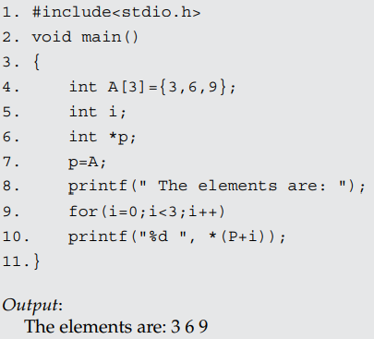

Slide 23


NULL Pointer
A null pointer in C is a pointer that is assigned to zero or NULL where a variable that has no valid address.
The null pointer usually does not point to anything.
In C programming language NULL is a macro constant that is defined in a few of the header files like stdio.h, alloc.h, mem.h, stddef.h, stdlib.h.
Also, note that NULL should be used only when we are dealing with pointers only.

Slide 24
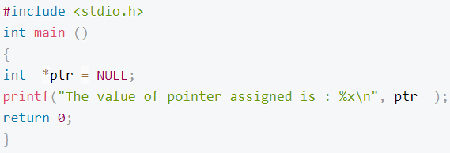

Null Pointer

Slide 25
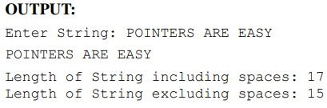
Pointers and strings
void main()
{
char str[20],*s;
int p=0,q=0;
clrscr();
printf(“Enter String :”);
gets(str);
s=str;
while(*s!=‘\0’)
{
printf(“%c”,*s);
p++;
s++;
if(*s==32) /* ASCII equivalnet of ‘ ’ (space)is 32*/
q++;
}
printf(“\nLength of String including spaces : %d”,p);
printf(“\nLength of String excluding spaces : %d”,p-q);
}

Slide 26
void main()
{
char *names[]=
{ “kapil”, “manoj”, “amit”,“amol”,
“pavan”,“mahesh”
} ;
char *tmp;
printf(“Original : %s %s”,names[3],names[4]);
tmp=names[3];
names[3]=names[4];
names[4]=tmp;
printf(“\nNew : %s %s”,names[3],names[4]);
}
OUTPUT:
Original : amol pavan
New : pavan amol

